Slide 1
Axalta™ Coating Systems
Precidium™ Flooring Systems
Axalta Coating Systems

Slide 2
Meeting Purpose
The purpose of this presentation is to communicate our new product offering. We have developed a spray-on floor coating that is designed to replace vinyl and rubber flooring in heavy rail, and light rail transportation vehicles.
Precidium is a seamless floor coating designed to protect subfloors from water damage while wearing better than current rubber and vinyl floors. It is available in a variety of colors that will satisfy your most demanding customers.

Slide 3
Executive Summary
Precidium™ Floor Coating System, distributed by Axalta,
offers transit authorities an advanced floor coating
system for transportation rail to enhance performance,
aesthetics and ease of maintenance compared to
traditional flooring.

Slide 4
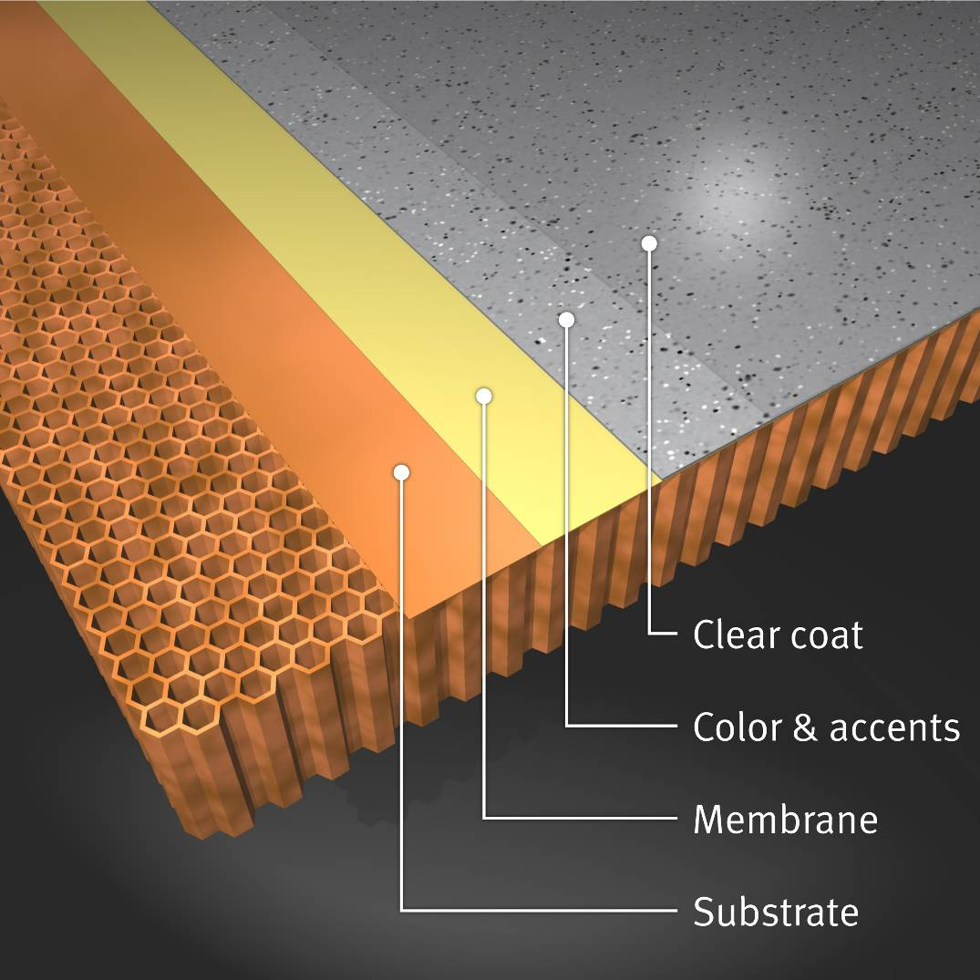
System
A System Approach
Unlike traditional rubber or vinyl, Precidium is a multilayer
sprayed-on coating that can be easily applied to
virtually any vertical or horizontal surface, creating a
lightweight, seamless and impermeable membrane.

Slide 5
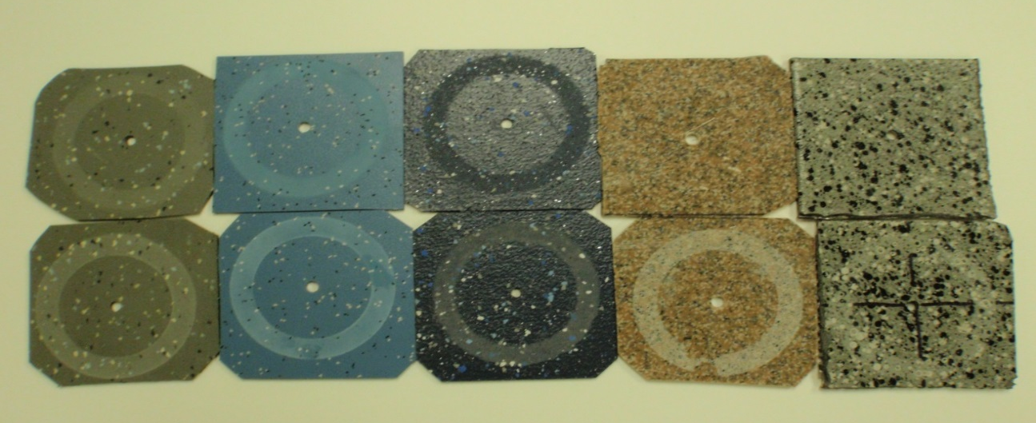
System
Reduce Maintenance Costs
Precidium is easy to keep clean and maintain which can lead
to a more pleasant commuter experience. Its seamless nature
means it is less likely dirt can collect between panels. And, it
will minimize the wear and tear from thousands of
commuters due to its excellent abrasion and impact resistance.

Slide 6
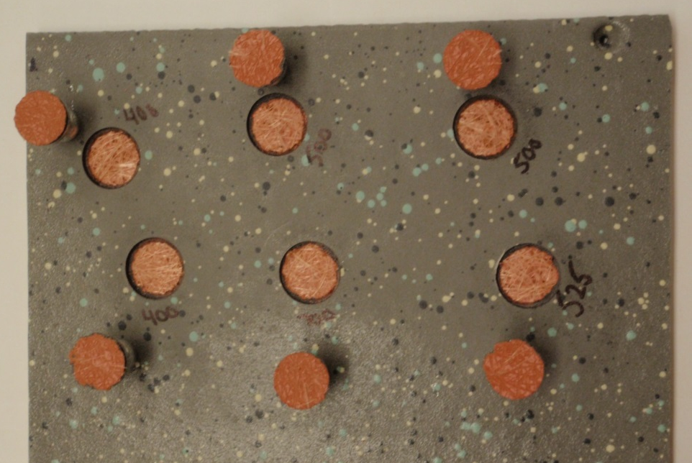
Durability
Increase durability
Precidium is designed to deliver exceptional adhesion
and impact resistance that can help to extend the life
of the floor and decrease maintenance costs.

Slide 7
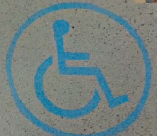
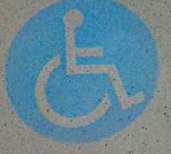
Durability
Enhanced design flexibility
Available in a range of solid colors or with optional splash
accents for a designer finish, the Precidium Floor Coating
System can be easily customized to meet your specific needs.
For example, logos and safety markings can be embedded in
the floor coating.

Slide 8
Precidium
Feature
Benefit
Looks Great.
Lasts Long.
Cost Effective.
Maintenance.
Satisfies the most demanding customers with astatically pleasing color pallets.
The test data suggests that Precidium last longer than traditional rubber and vinyl flooring products.
Precidium offers lower applied cost versus traditional rubber and vinyl flooring products.
Easy to clean with no seams that trap dirt and moisture.

Slide 9
Precidium
Feature
Benefit
Meets ADA specifications.
Smoke and toxicity specification.
Abrasion and Durability.
Seamless floor membrane.
Flexibility in design.
The coefficient of friction ranges from .6 to 1.0 which meets or exceeds the wet or dry American Disability Act’s specification for transportation foot traffic.
Precidium products meet all smoke and toxicity testing for rail applications.
Precidium provides exceptional abrasion and impact resistance extending the life of the floor decreasing maintenance costs.
Precidium offers a seamless floor membrane that protects the subfloor from moisture and prevents deterioration and rotting of subfloor substrates.
Available in a wide range of base color and splash accents that will meet the specific needs to match any flooring color and design.

Slide 10
Thank You

